Slide 1
Kiran sunkari Kunal choudhary
Lending case study

Slide 2
Objective
The objective of this case study is to explore various methods for analyzing data, apply Exploratory Data Analysis (EDA) techniques to a real-world problem, and derive meaningful insights
For any ML/AI solution, understanding the business problem is the most critical step. In this context, EDA serves as the first step to identify the key features for our ML or AI solutions.

Slide 3
Dataset understanding &cleaning
Removed all columns and rows that contain only null values.
Deleted the duplicate rows and columns
Grouped the quantitative variables, such as annual_inc, int_rate, and dti
Analyzed individual columns and removed outliers. For example, in the case of annual_inc, all records beyond the 95th percentile were excluded, retaining only the records up to the 95th percentile.

Slide 4
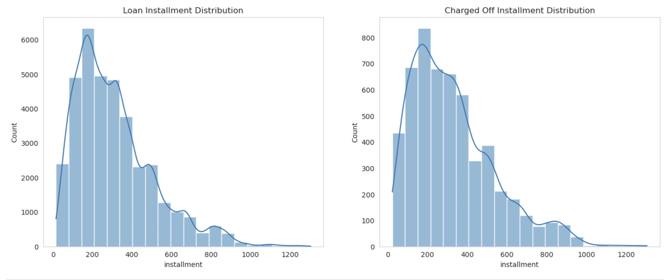
Loan Installment Distribution
Performed univariate analysis by plotting the distribution graph for loan installment property, comparing loan-defaulters with the entire dataset. No signals were observed in the loan installment data.

Slide 5
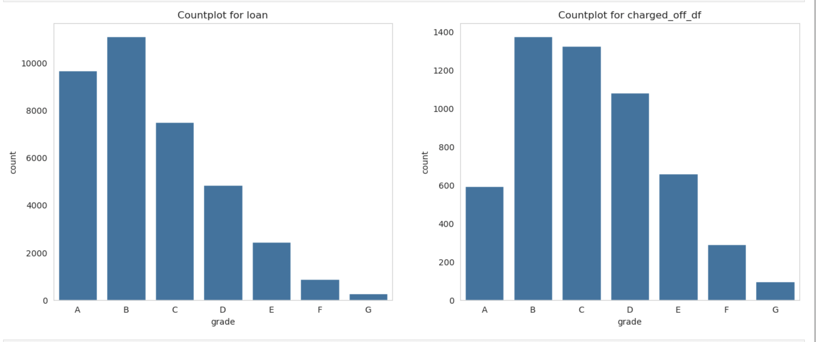
Grade property analysis
When analyzing the Grade property, we observe that the Grade 'C' category has a higher proportion of defaulters compared to other grades.

Slide 6
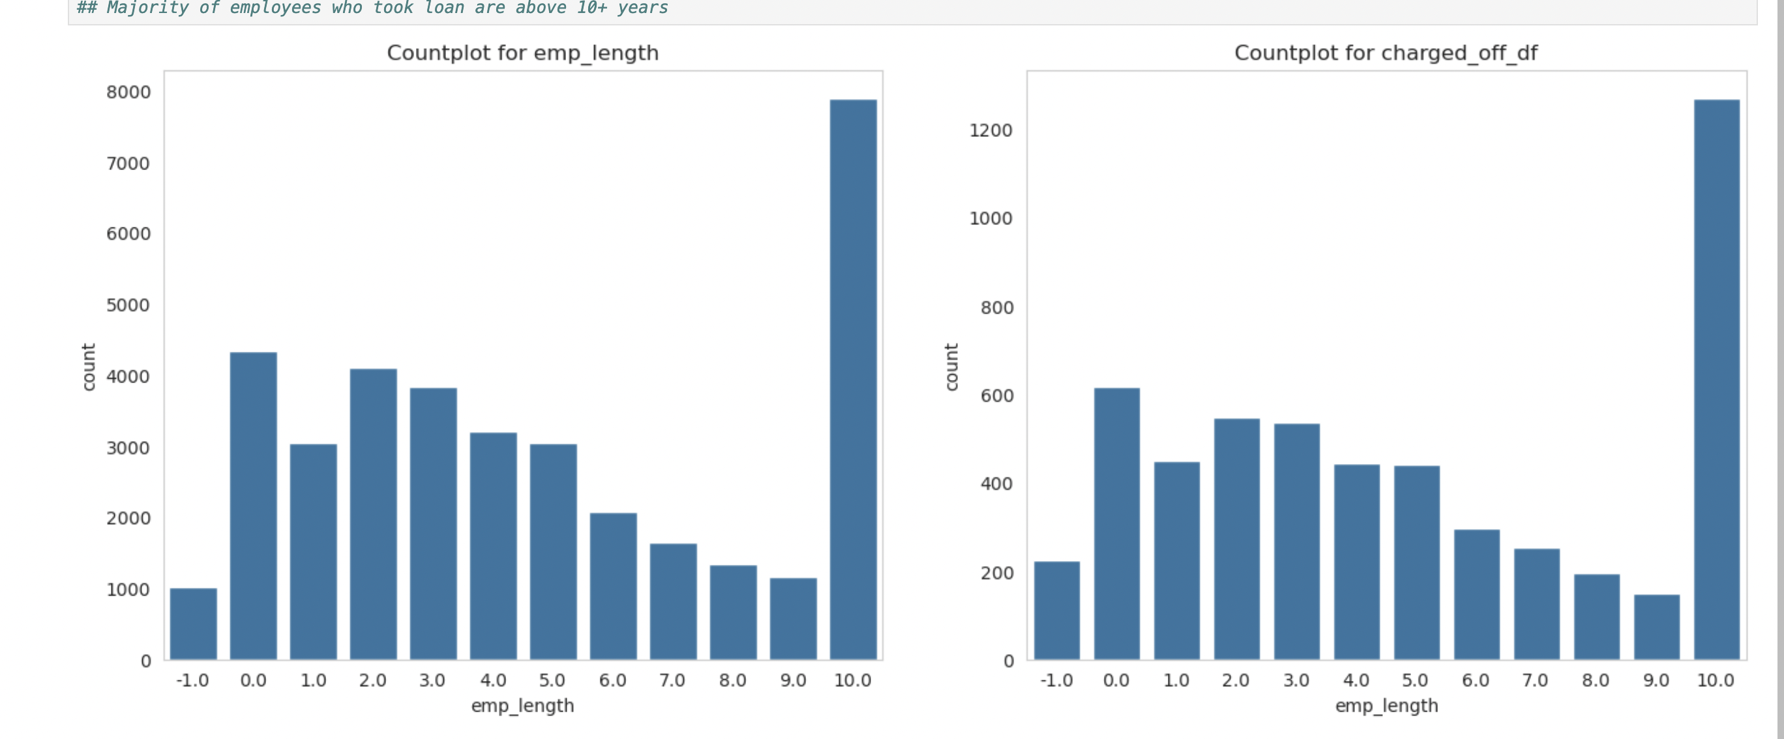
Employee length
By examining the distributions, the employee length does not provide any meaningful signal. We need to add another property to validate this.

Slide 7
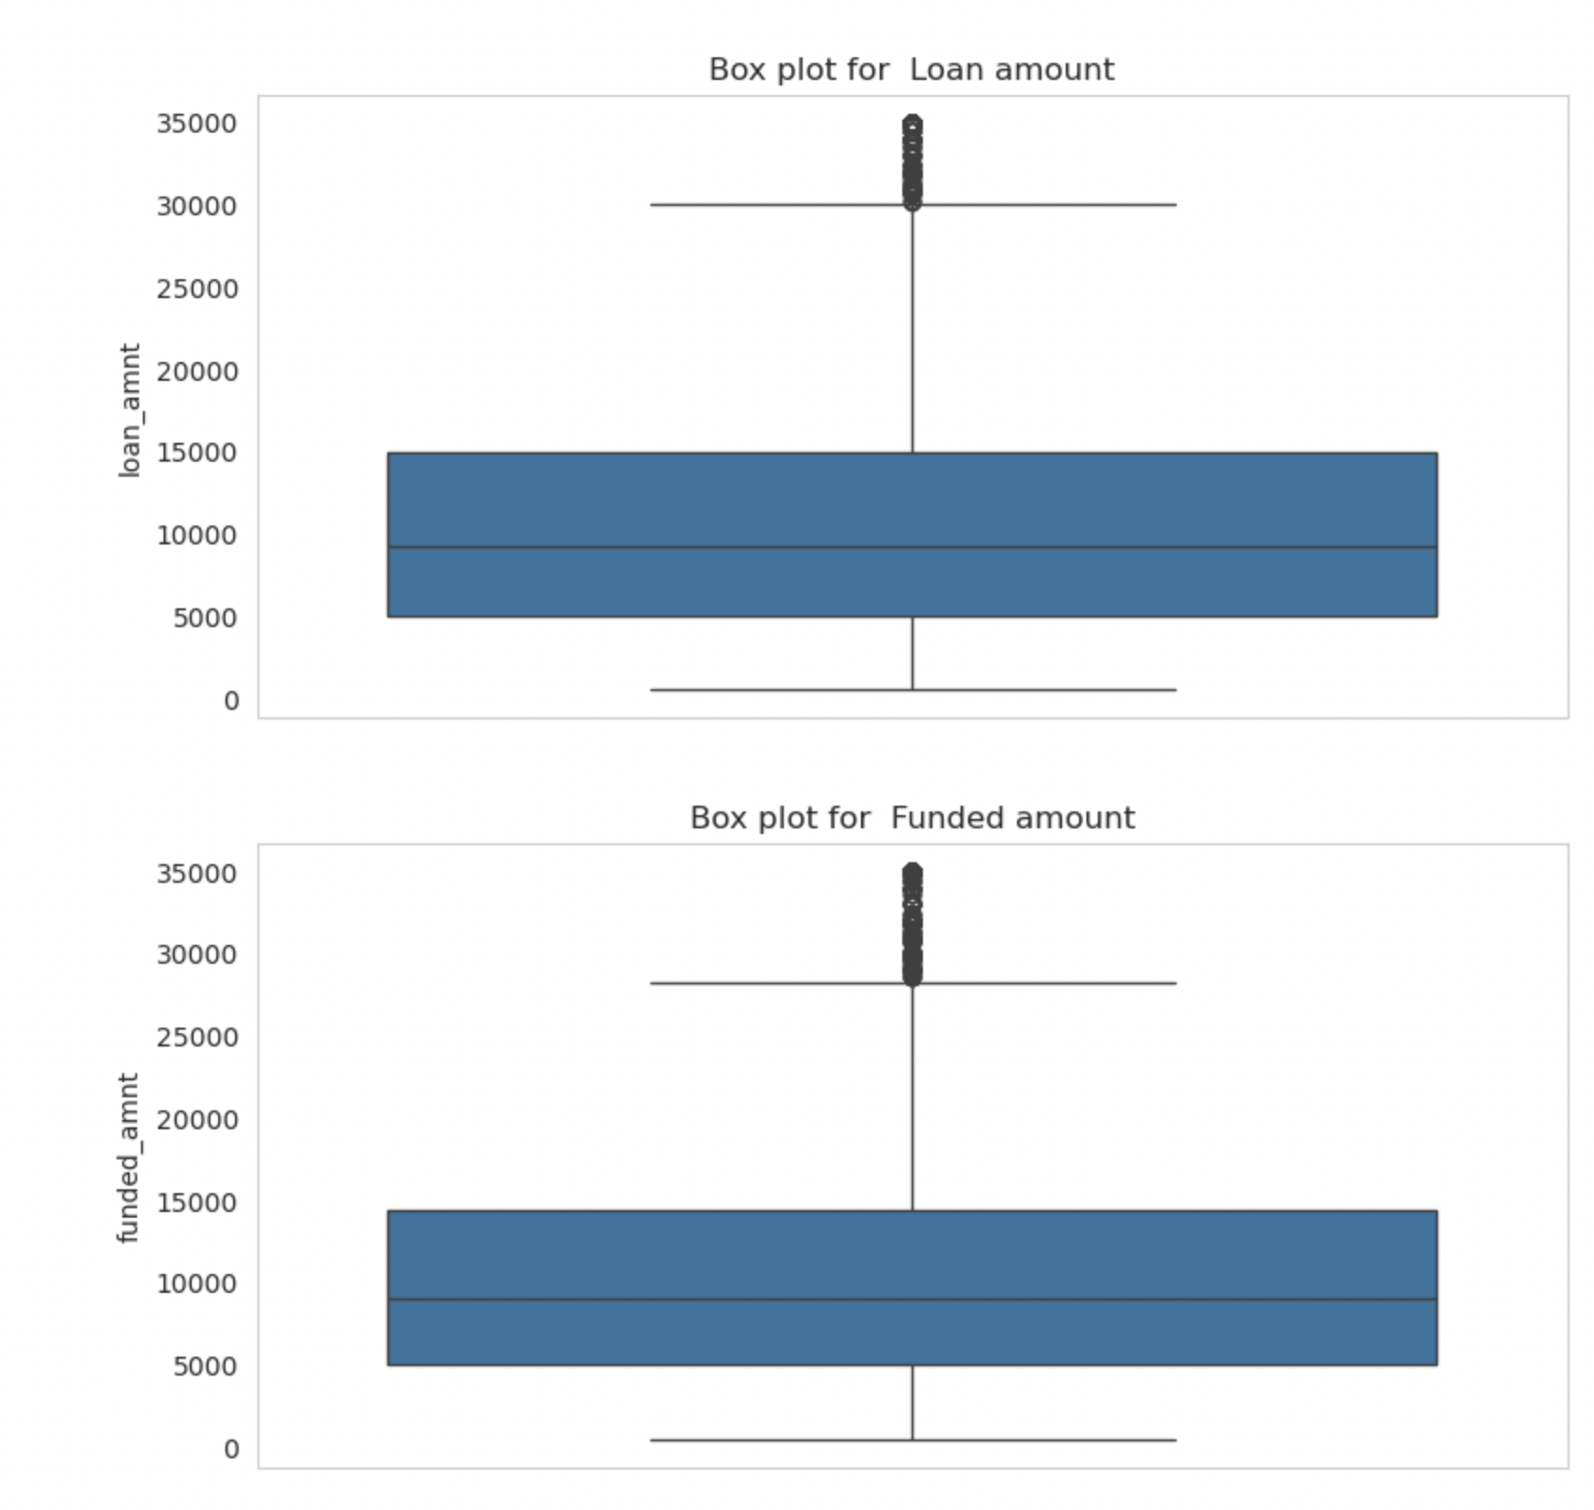
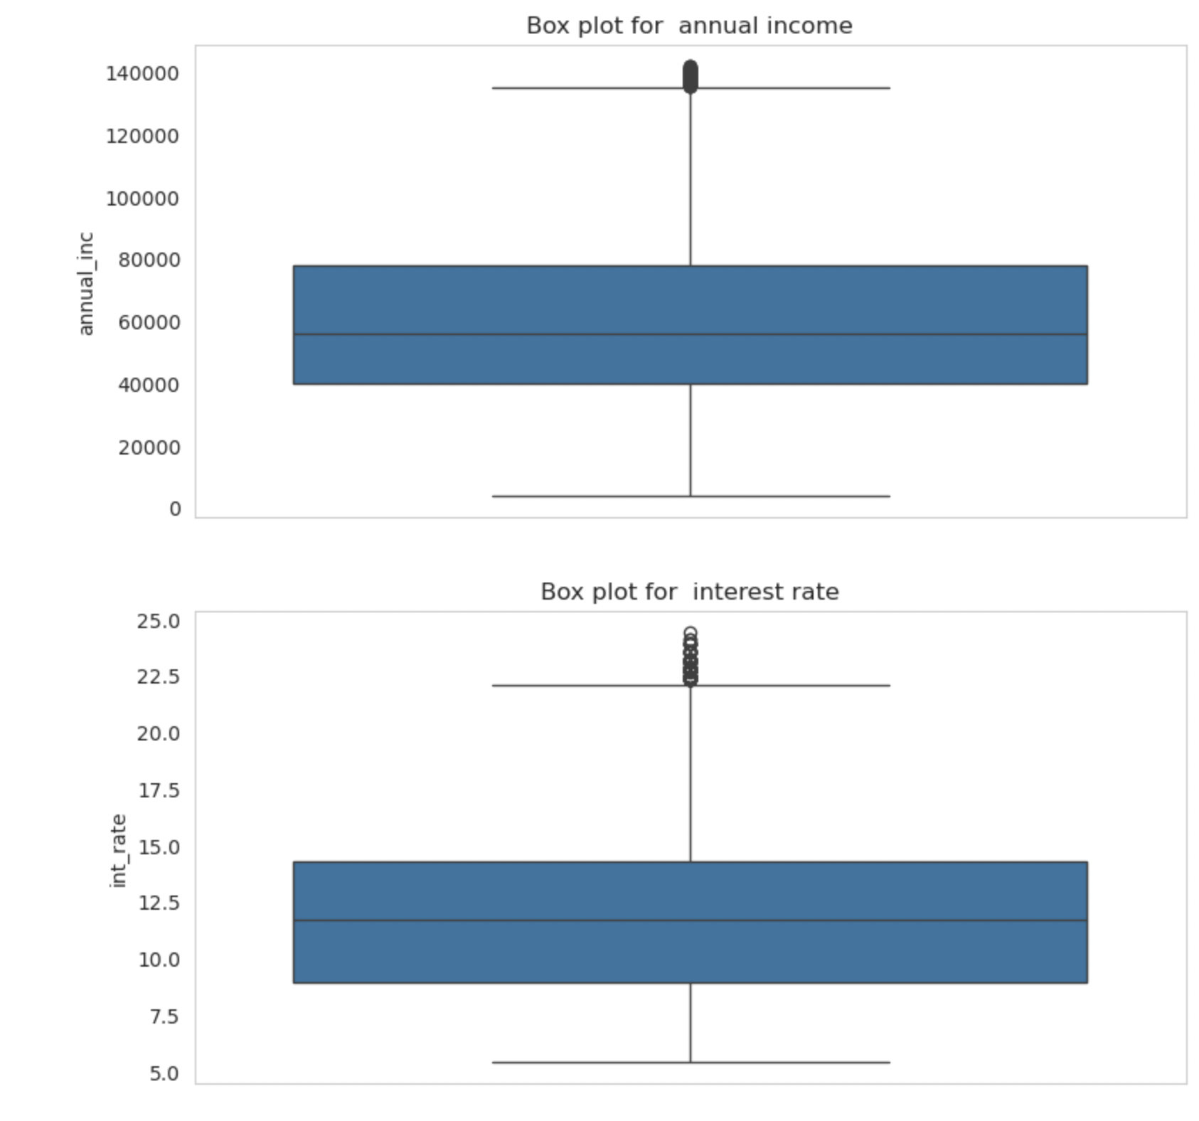
Analyzing quantitative variables
Plotted the box plots to understand the distribution of quantitative variables, remove the outliers based on the IQR, and perform data bucketing based on the IQR distribution

Slide 8
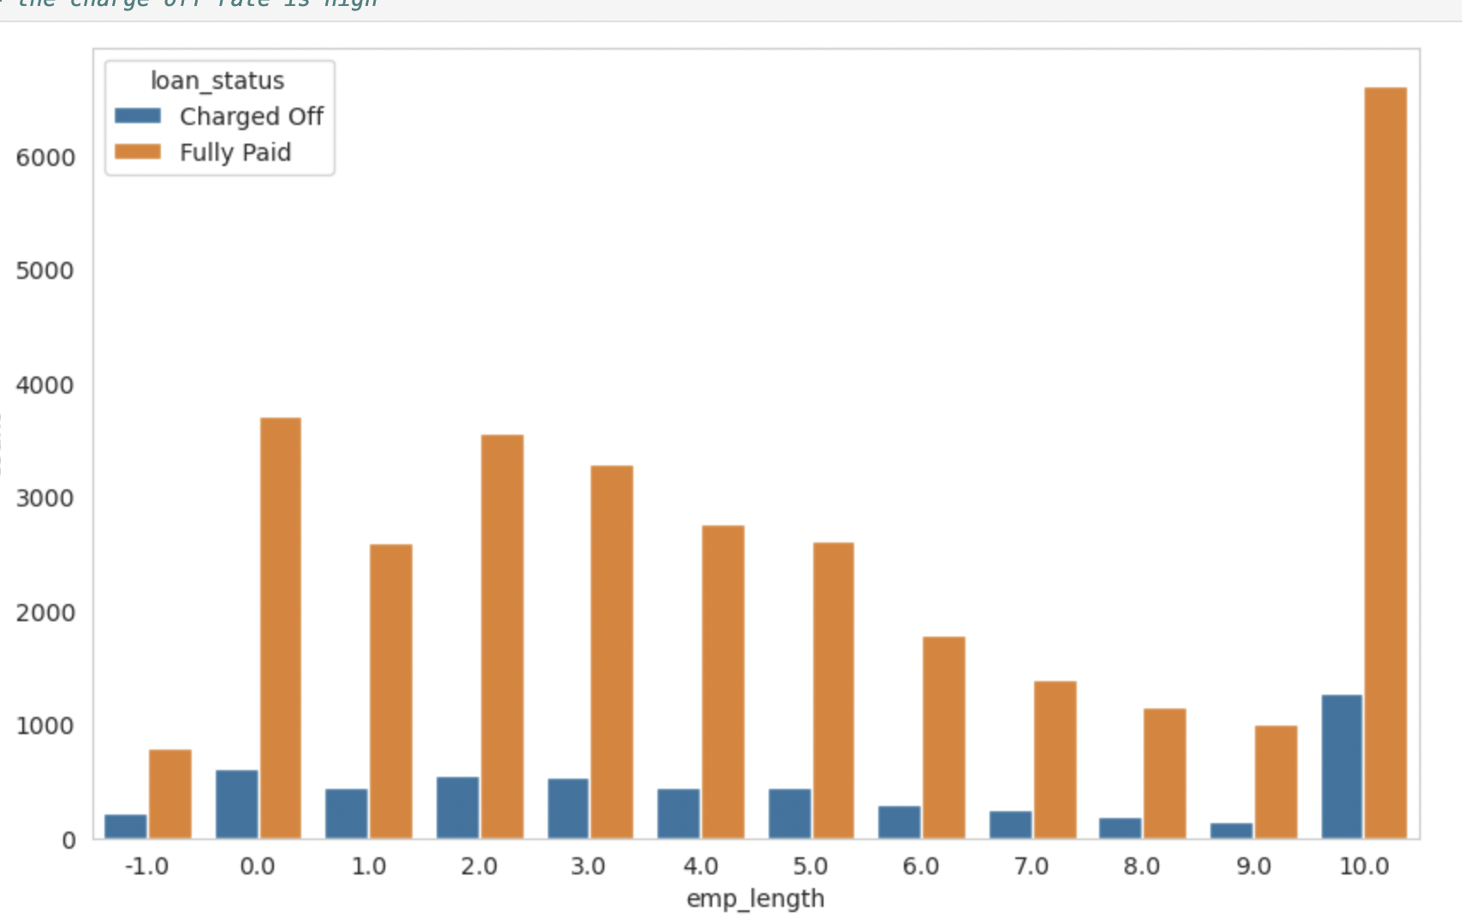
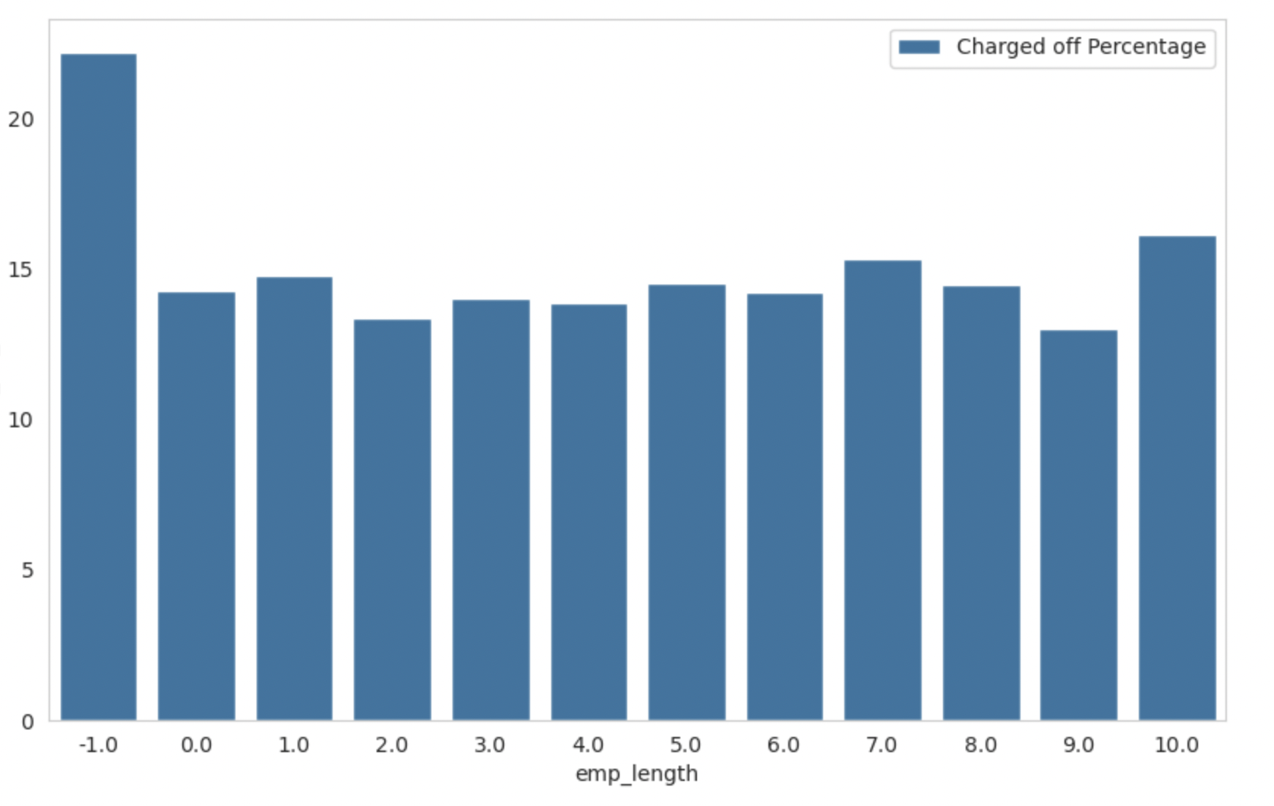
Employee length analysis
multivariate analysis: when plotting the employee length against loan status, no significant signal is observed. However, when plotting the charged-off percentage, it becomes apparent that records without an employee length (which may indicate that the applicant is not employed) have a higher default rate.

Slide 9
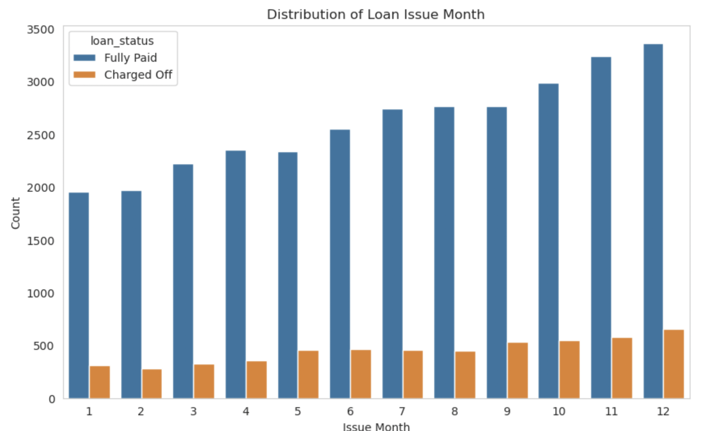
Month attribute analysis
Based on the distribution, we can observe that loans issued at the end of the year have a higher default rate

Slide 10
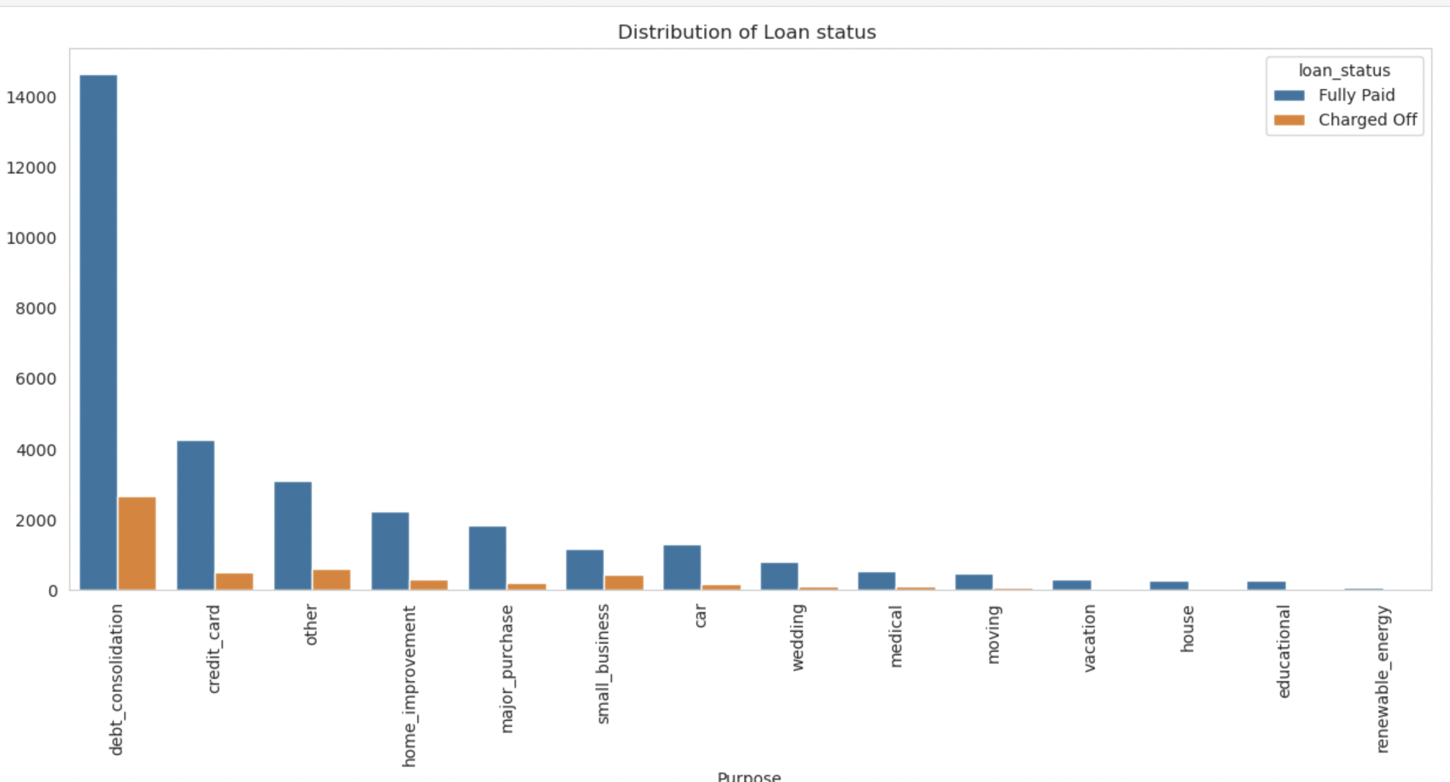
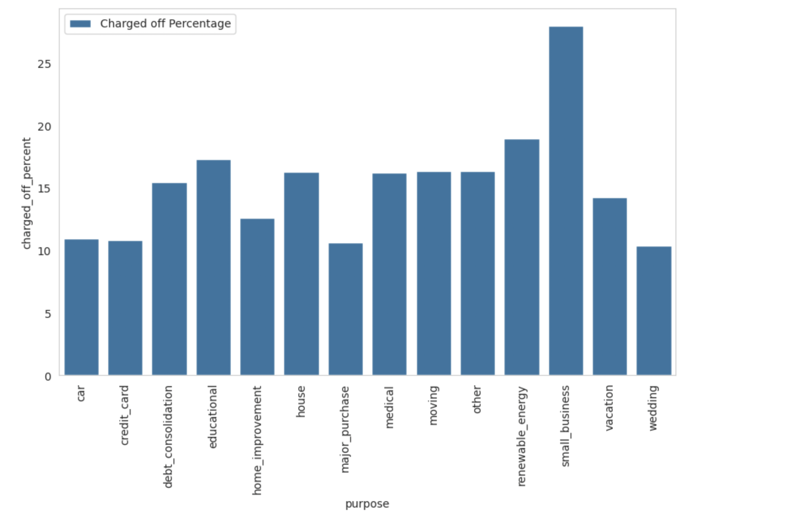
Purpose analysis
Upon analysis, we can observe that loans given for small businesses have a higher chance of default..

Slide 11
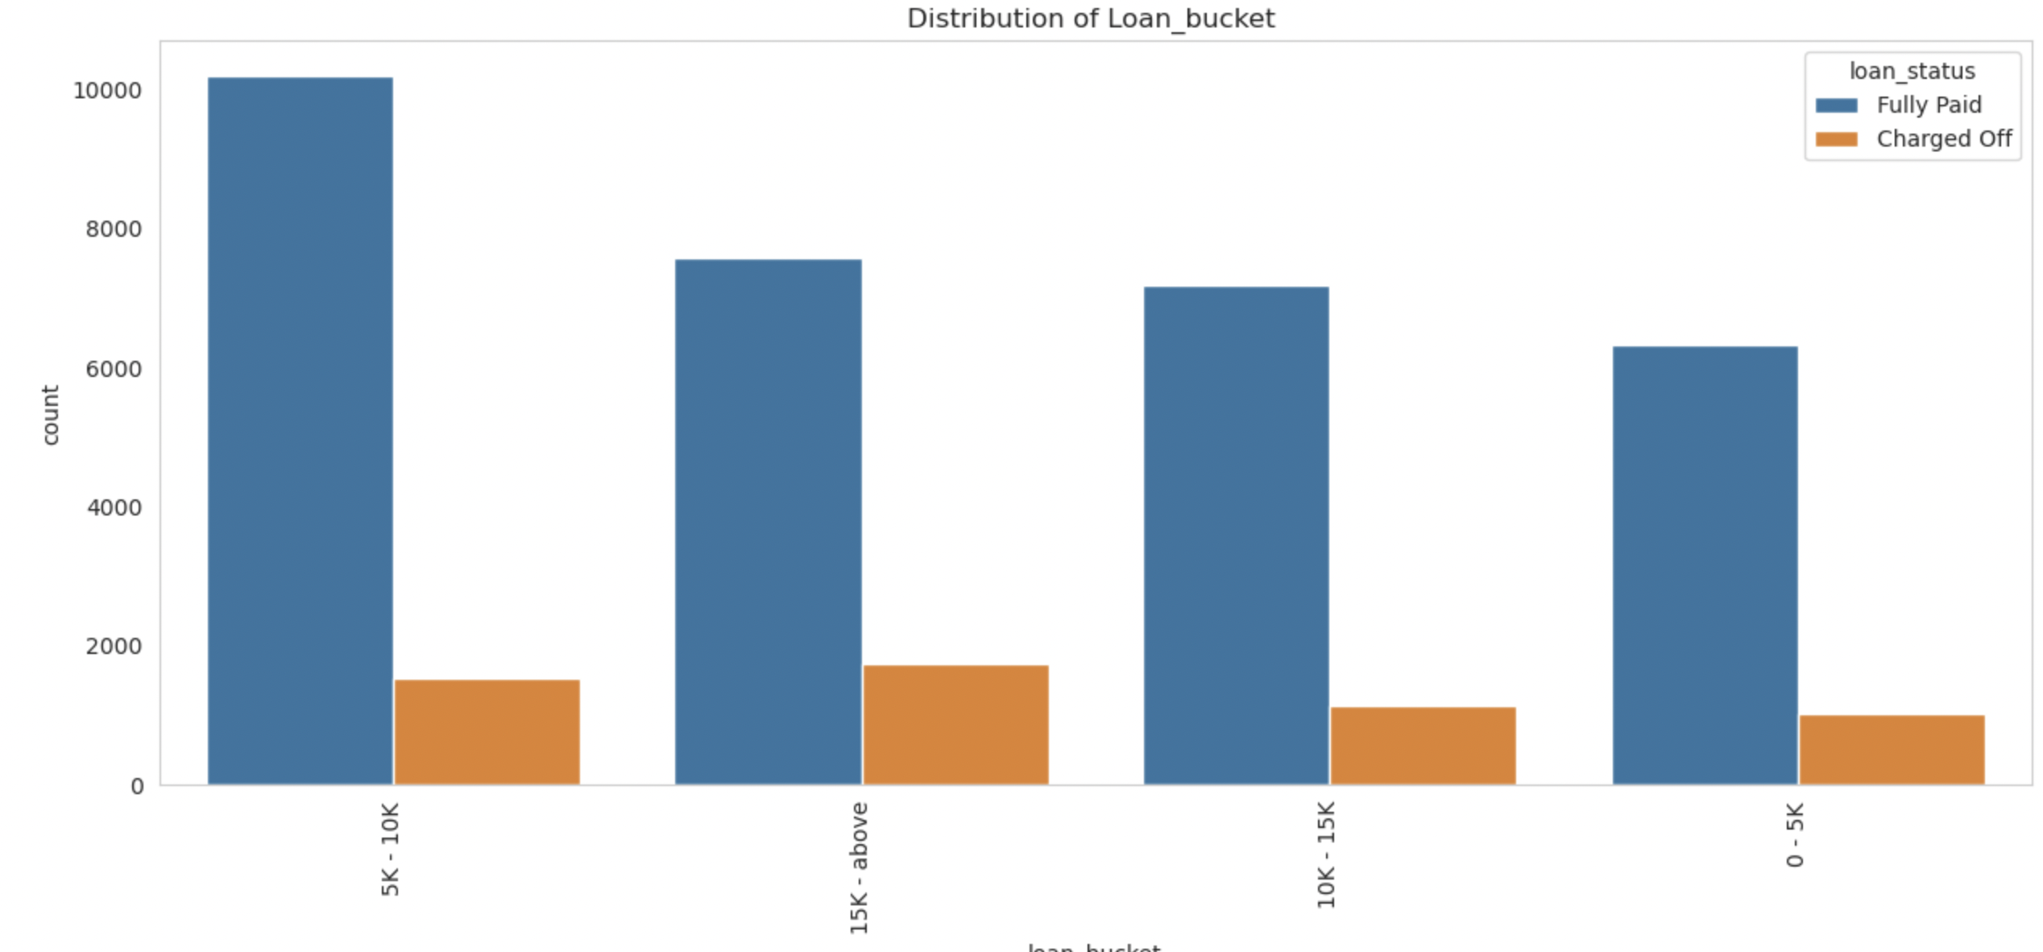
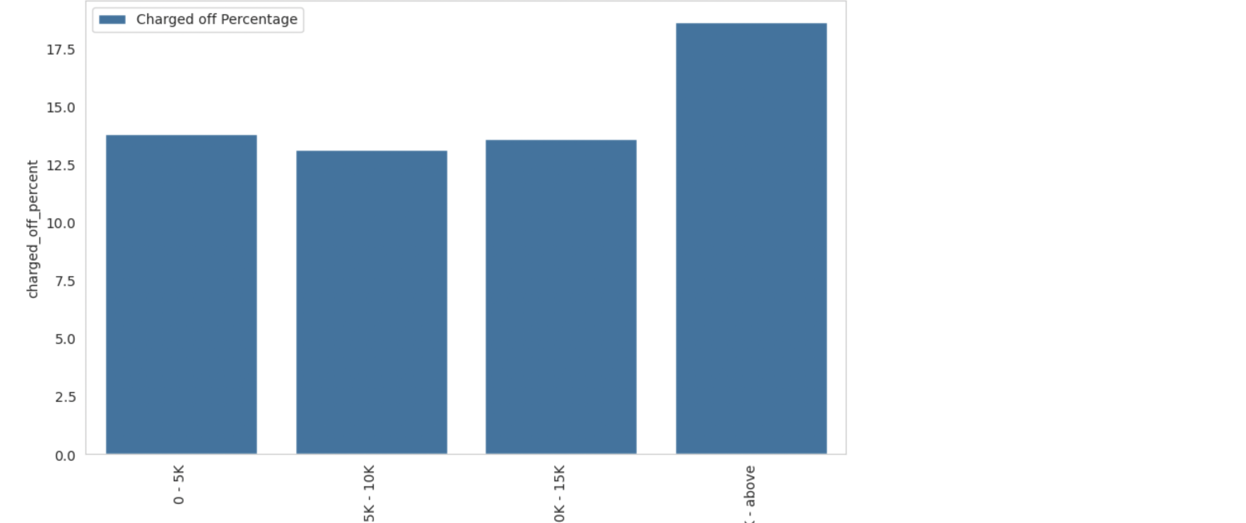
Loan amount bucket analysis
Upon analysis, we can observe that loan amount greater than 15k has a higher chance of default. But we need to check with other parameters

Slide 12
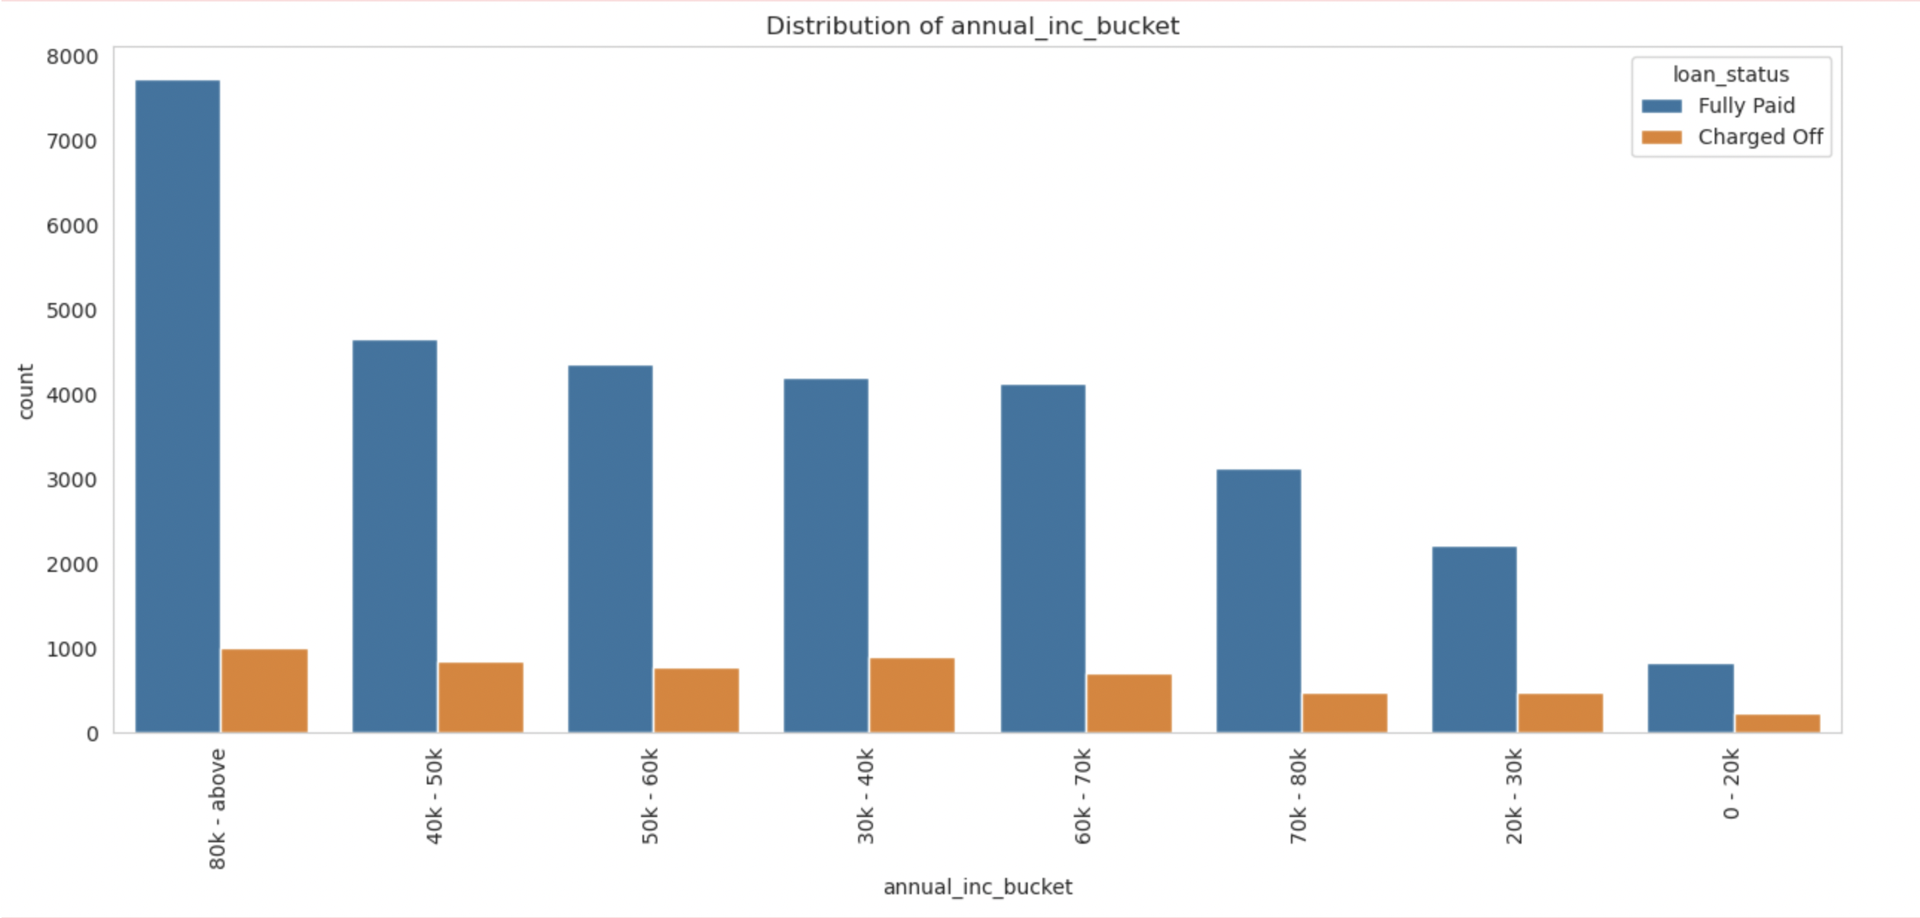
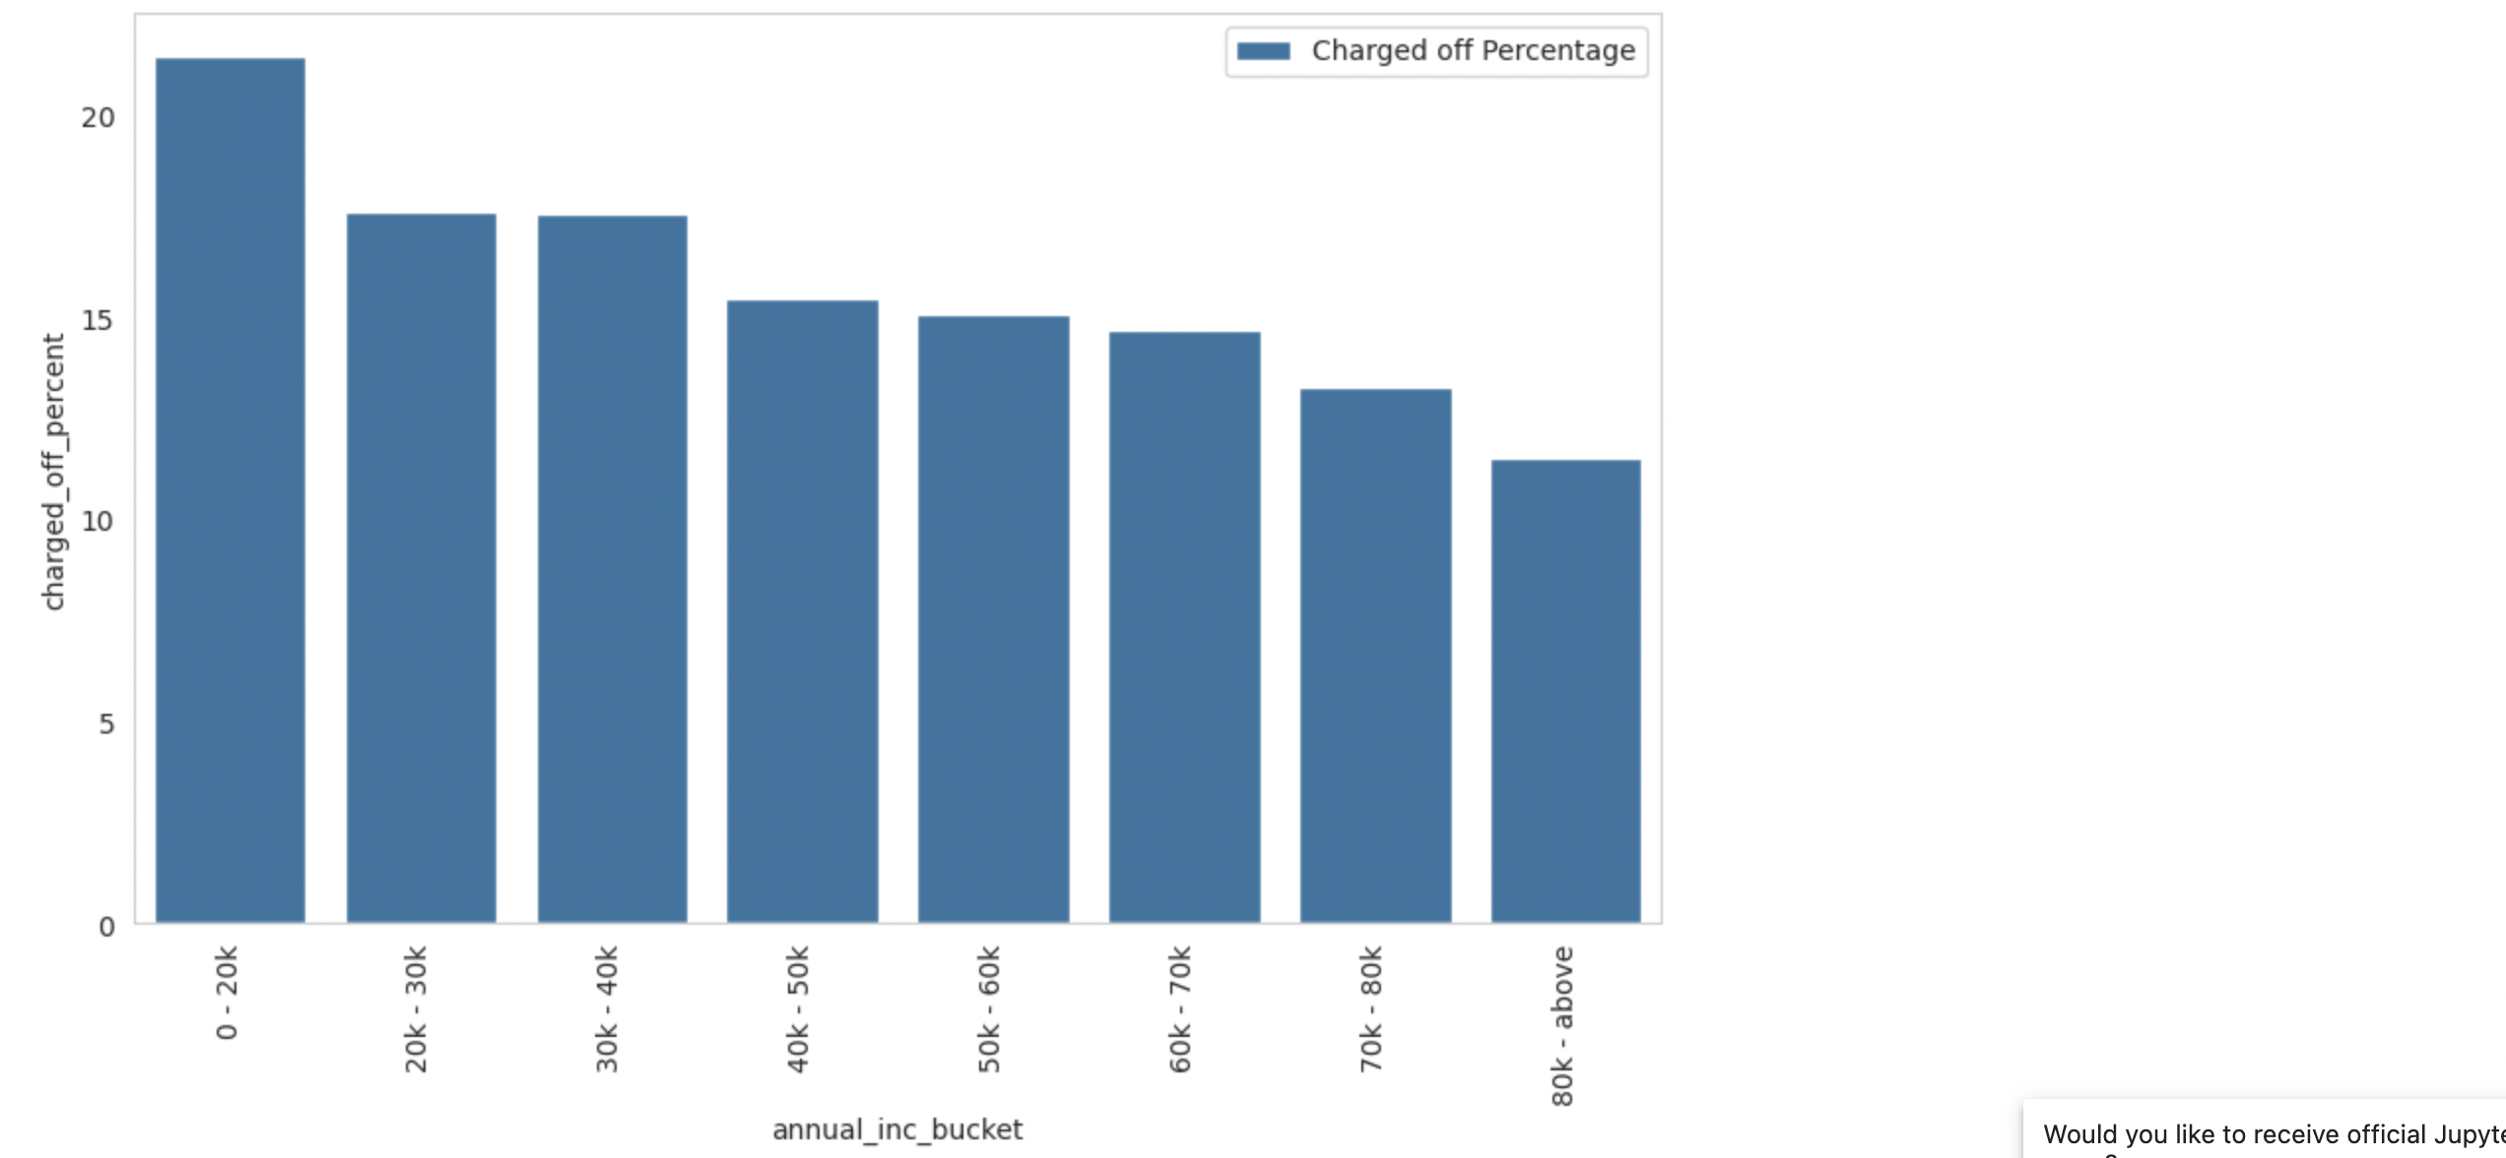
Annual income analysis
Upon analysis, we can observe that loans given for people with annual income less than 20k has a higher chance of default.

Slide 13
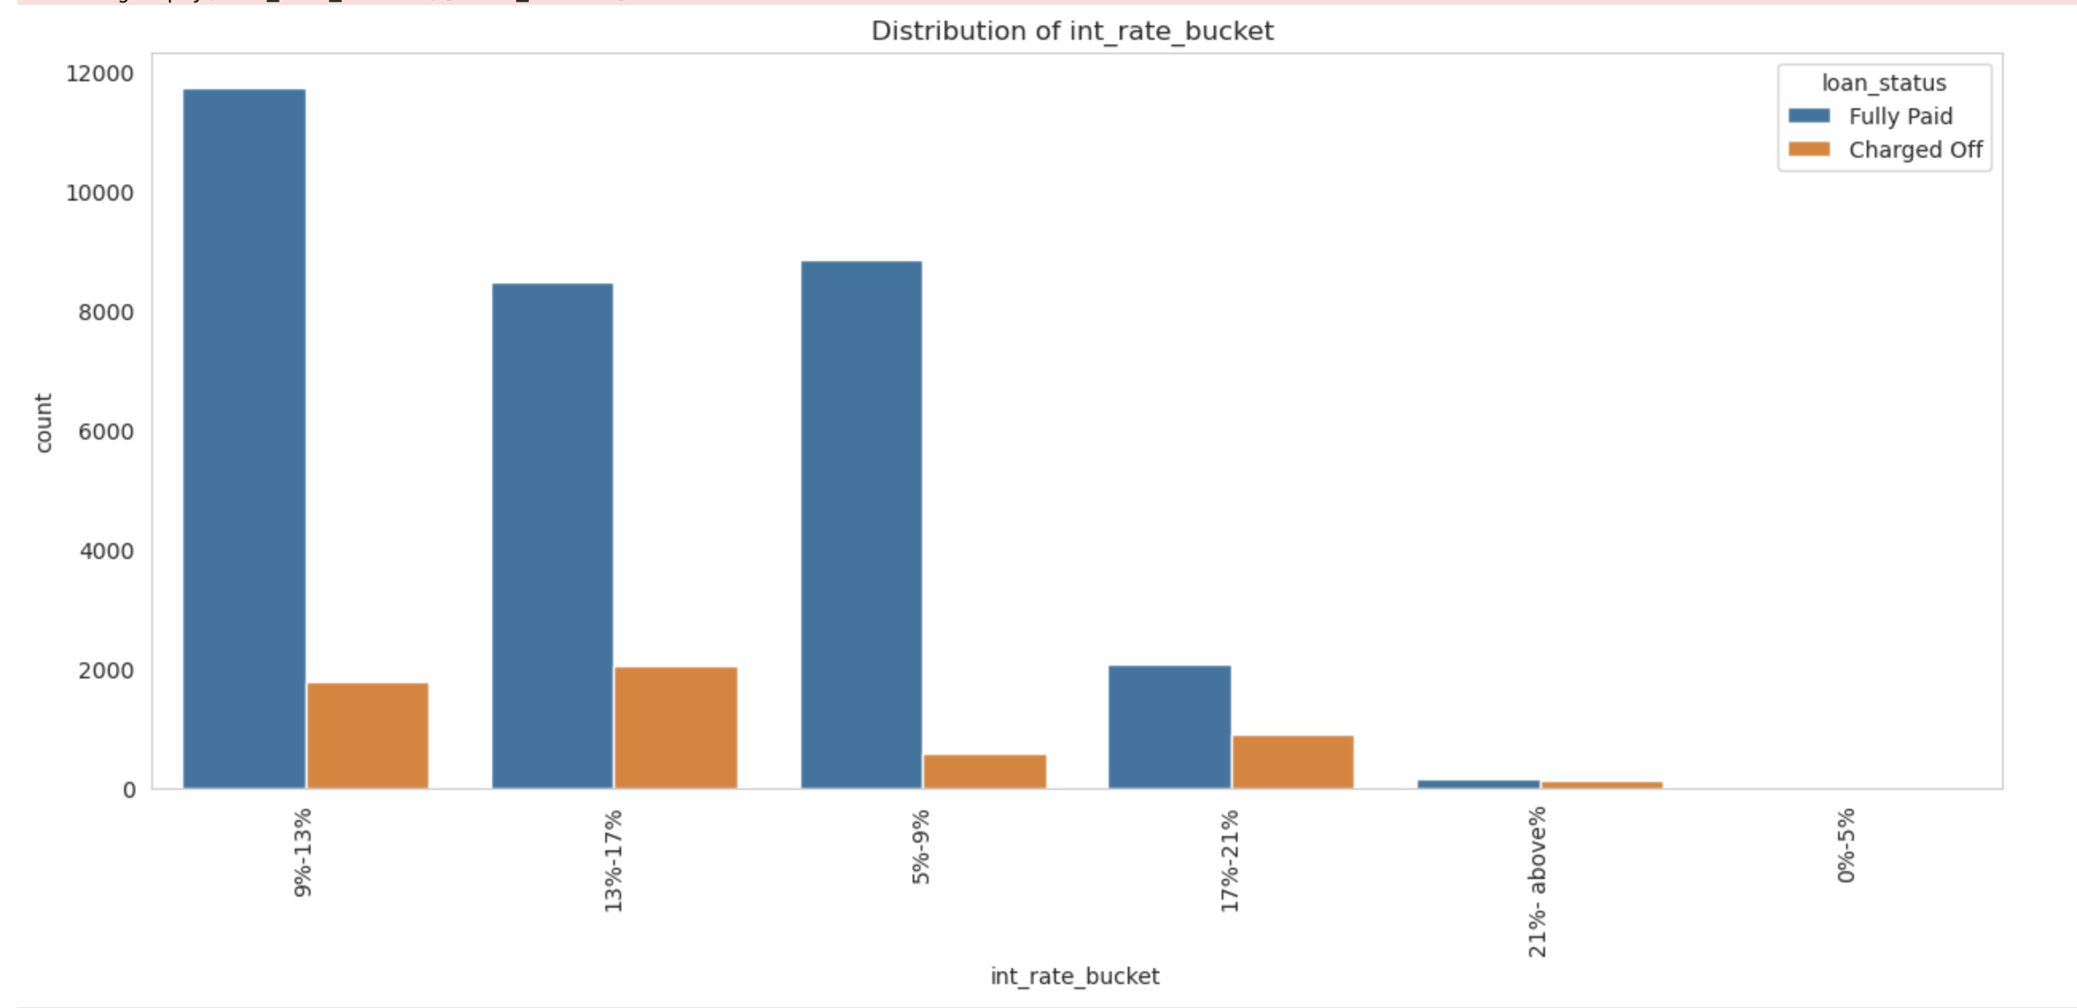
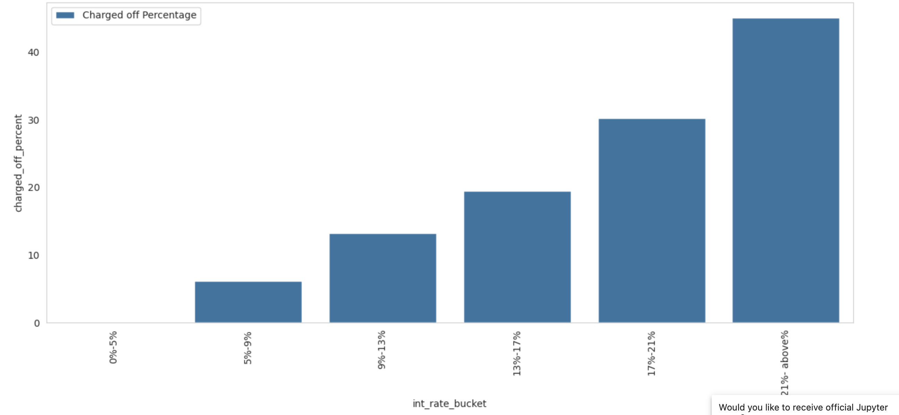
Interest rate analysis
Upon analysis, we can observe that loans given with higher interest rate has
higher chance of default

Slide 14
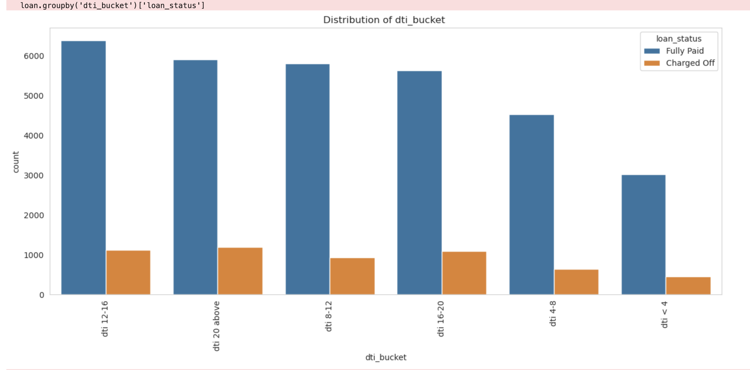
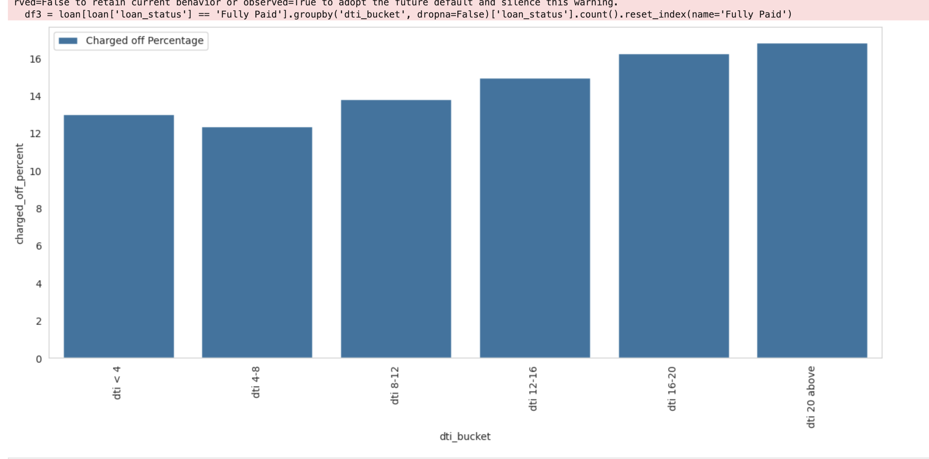
DTI Analysis
Upon analysis, we can observe that applicants with high dti rate has more chance of loan default

